Slide 1

Statistical analysis on Covid 19
Statistical approach and hypothesis testing
by- shaziya banu s

Slide 2
Statistical analysis on Covid 19
Analysis is performed on different cases.
Analysis on different states of india.
Analysis is carried out in different year.

Slide 3

Coronaviruses are a large family of viruses which may cause illness in animals or humans. In humans, several coronaviruses are known to cause respiratory infections ranging from the common cold to more severe diseases such as Middle East Respiratory Syndrome (MERS) and Severe Acute Respiratory Syndrome (SARS). The most recently discovered coronavirus causes coronavirus disease COVID-19 - World Health Organization

Slide 4

The number of new cases are increasing day by day around the world. This dataset has information from the states and union territories of India at daily level.
State level data comes from Ministry of Health & Family Welfare
Testing data and vaccination data comes from covid19india.

Slide 5
Acknowledgement
Thanks to Indian Ministry of Health & Family Welfare for making the data available to general public.
Thanks to covid19india.org for making the individual level details, testing details, vaccination details available to general public.
Thanks to Wikipedia for population information.
Thanks to the Team at ISIBang
Photo Courtesy - https://hgis.uw.edu/virus/

Slide 6
Samples were collected all over India and testing results were given on the every day basis.
Various analysis can be performed depending upon samples collected, confirmed cases, positive cases, negative cases, death rates and so on.
From the data set, we can obtain the Top 10 states with highest number of Confirmed cases
Top 10 states with highest number of Confirmed cases
Top 10 confirmed staes | Sum of Confirmed
Maharashtra | 1062527640
Karnataka | 458832046
Kerala | 426597134
Tamil Nadu | 407184930
Andhra Pradesh | 372890428
Uttar Pradesh | 296111211
Delhi | 273687243
West Bengal | 248252234
Chhattisgarh | 154487241
Rajasthan | 153492758
Grand Total | 3854062865
According to the above information Maharashtra is on Top 1 place with 1062527640 confirmed cases
Rajasthan is in Top 10th place with 153492758 confirmed cases.

Slide 7
From the data set, we can obtain the Bottom 10 states with highest number of Confirmed cases
Bottom 10 states with highest number of Confirmed cases
Bottom 10 confirmed states | Sum of Confirmed
Andaman and Nicobar Islands | 1875543
Bihar**** | 1430909
Cases being reassigned to states | 345565
Dadra and Nagar Haveli | 20722
Dadra and Nagar Haveli and Daman and Diu | 1849234
Daman & Diu | 2
Himanchal Pradesh | 204516
Lakshadweep | 833482
Madhya Pradesh*** | 791656
Unassigned | 161
Grand Total | 7351790
According to the above information, the bottom 10 states are shown along with their value.

Slide 8
From the data set, we can obtain the Top 10 states with highest number of Cured cases
Top 10 states with highest number of Cured cases
Top 10 cured staes | Sum of Cured
Andhra Pradesh | 352926995
Chhattisgarh | 142720847
Delhi | 260720476
Karnataka | 416155734
Kerala | 390311164
Maharashtra | 963584102
Odisha | 142222495
Tamil Nadu | 381444416
Uttar Pradesh | 276311742
West Bengal | 233983721
Grand Total | 3560381692
According to the above information Maharashtra is on Top 1 place with 963584102 cured cases
Odisha is in Top 10th place with 142222495 cured cases.

Slide 9
From the data set, we can obtain the Bottom10 states with highest number of Cured cases
Bottom 10 states with highest number of Cured cases
Bottom 10 cured sates | Sum of Cured
Andaman and Nicobar Islands | 1781610
Bihar**** | 1402468
Cases being reassigned to states | 0
Dadra and Nagar Haveli | 20352
Dadra and Nagar Haveli and Daman and Diu | 1746014
Daman & Diu | 0
Himanchal Pradesh | 200040
Lakshadweep | 729839
Madhya Pradesh*** | 780735
Unassigned | 0
Grand Total | 6661058
According to the above information, the bottom 10 states with cured cases are shown along with their value.

Slide 10
From the data set, we can obtain the Top 10 states with highest number of Death cases
Top 10 states with highest number of Death cases
Top 10 death rate staes | Sum of Deaths
Andhra Pradesh | 2817970
Chhattisgarh | 1942099
Delhi | 4717732
Gujarat | 2128759
Karnataka | 5723143
Maharashtra | 22534416
Punjab | 2638818
Tamil Nadu | 5608369
Uttar Pradesh | 3938519
West Bengal | 3683145
Grand Total | 55732970
According to the above information Maharashtra is on Top 1 place with 22534416 death cases
Chhattisgarh is 10th place with 1942099 death cases.

Slide 11
From the data set, we can obtain the Bottom 10 states with Death cases
Bottom 10 states with highest number of Death cases
Bottom 10 death rate states | Sum of Deaths
Bihar**** | 18881
Cases being reassigned to states | 0
Dadra and Nagar Haveli | 8
Dadra and Nagar Haveli and Daman and Diu | 978
Daman & Diu | 0
Himanchal Pradesh | 3507
Lakshadweep | 3457
Madhya Pradesh*** | 10506
Mizoram | 8331
Unassigned | 0
Grand Total | 45668
According to the above information, the bottom 10 states with death cases are shown along with their value

Slide 12
From the data set, we can obtain the Top 10 states with highest Death percentage
Top 10 states with highest of Death percentage
Top 10 state's death percentage | Sum of Deaths
Andhra Pradesh | 5.06%
Chhattisgarh | 3.48%
Delhi | 8.46%
Gujarat | 3.82%
Karnataka | 10.27%
Maharashtra | 40.43%
Punjab | 4.73%
Tamil Nadu | 10.06%
Uttar Pradesh | 7.07%
West Bengal | 6.61%
Grand Total | 100.00%
According to the above information Maharashtra is on Top 1 place with 40% death cases.
Chhattisgarh is in 10th place with 3.48% death cases.

Slide 13
From the data set, we can obtain the Bottom 10 states with highest Death percentage
Bottom 10 states with highest of Death percentage
Bottom 10 state's death percentage | Sum of Deaths
Bihar**** | 41.34%
Cases being reassigned to states | 0.00%
Dadra and Nagar Haveli | 0.02%
Dadra and Nagar Haveli and Daman and Diu | 2.14%
Daman & Diu | 0.00%
Himanchal Pradesh | 7.68%
Lakshadweep | 7.57%
Madhya Pradesh*** | 23.01%
Mizoram | 18.24%
Unassigned | 0.00%
Grand Total | 100.00%
According to the above information, the bottom 10 states with death percentage is shown along with its value.

Slide 14
From the data set, we can obtain the Top 10 states with highest number of total samples
Top 10 states with highest number of Total Samples
Top 10 states with higher no of total sample | Sum of TotalSamples
Andhra Pradesh | 4127211823
Bihar | 6121329928
Delhi | 3499131565
Gujarat | 3745364851
Karnataka | 5453628818
Kerala | 3350897050
Maharashtra | 5703822545
Tamil Nadu | 5436042291
Telangana | 2680729201
Uttar Pradesh | 9155561731
Grand Total | 49273719803
According to the above information Uttar Pradesh is on Top 1 place with highest number of total samples.
Telangana is in 10th place with 2680729201.

Slide 15
From the data set, we can obtain the Bottom 10 states with highest number of total samples
Bottom 10 states with highest number of Total Samples
Bottom 10 states with highest number of Total Samples | Sum of TotalSamples
Andaman and Nicobar Islands | 72336655
Arunachal Pradesh | 132259016
Chandigarh | 79203122
Dadra and Nagar Haveli and Daman and Diu | 6324267
Ladakh | 27988511
Lakshadweep | 12622334
Meghalaya | 96858864
Mizoram | 64100385
Nagaland | 42911316
Sikkim | 23149220
Grand Total | 557753690
According to the above information, the bottom 10 states with highest number of total samples is shown along with its value.

Slide 16
From the data set, we can obtain the Top 10 states with highest number of negative cases.
Top 10 states with highest number of Negative cases
Top 10 states with high Negative case | Count of Negative
Andhra Pradesh | 405
Arunachal Pradesh | 428
Chandigarh | 444
Himachal Pradesh | 452
Jammu and Kashmir | 454
Jharkhand | 448
Madhya Pradesh | 411
Puducherry | 430
Tripura | 409
Uttarakhand | 455
Grand Total | 4336
According to the above information Uttarakhand is on Top 1 place with highest number of negative cases.
Andra pradesh is in 10th place with 405.

Slide 17
From the data set, we can obtain Bottom 10 states with highest number of negative cases.
Bottom 10 states with highest number of Negative cases
States | Count of Negative
Andaman and Nicobar Islands | 1
Assam | 48
Bihar | 1
Delhi | 22
Goa | 2
Mizoram | 2
Odisha | 13
Punjab | 51
Telangana | 30
West Bengal | 1
Grand Total | 171
According to the above information, the bottom 10 states with negative cases is shown along with its value.

Slide 18
From the data set, we can obtain the Top 10 states with highest number of positive cases
Top 10 states with highest number of Positive cases
States | Sum of Positive
Andhra Pradesh | 3859260
Delhi | 6848173
Gujarat | 8009517
Jharkhand | 46499325
Karnataka | 4701197
Kerala | 79723175
Maharashtra | 96901583
Puducherry | 6287323
Tamil Nadu | 12772604
Tripura | 10061637
Grand Total | 275663794
According to the above information Maharashtra is on Top 1 place with highest number of positive cases.
Andrapradesh is in 10th place with 3859260.

Slide 19
From the data set, we can obtain the Bottom 10 states with highest number of positive cases
Bottom 10 states with highest number of Positive cases
States | Sum of Positive
Arunachal Pradesh | 51245
Chandigarh | 59195
Dadra and Nagar Haveli and Daman and Diu | 169010
Himachal Pradesh | 119494
Ladakh | 89027
Manipur | 101501
Meghalaya | 33904
Mizoram | 19785
Nagaland | 90682
Sikkim | 17644
Grand Total | 751487
According to the above information, the bottom 10 states with positive cases is shown along with its value.

Slide 20
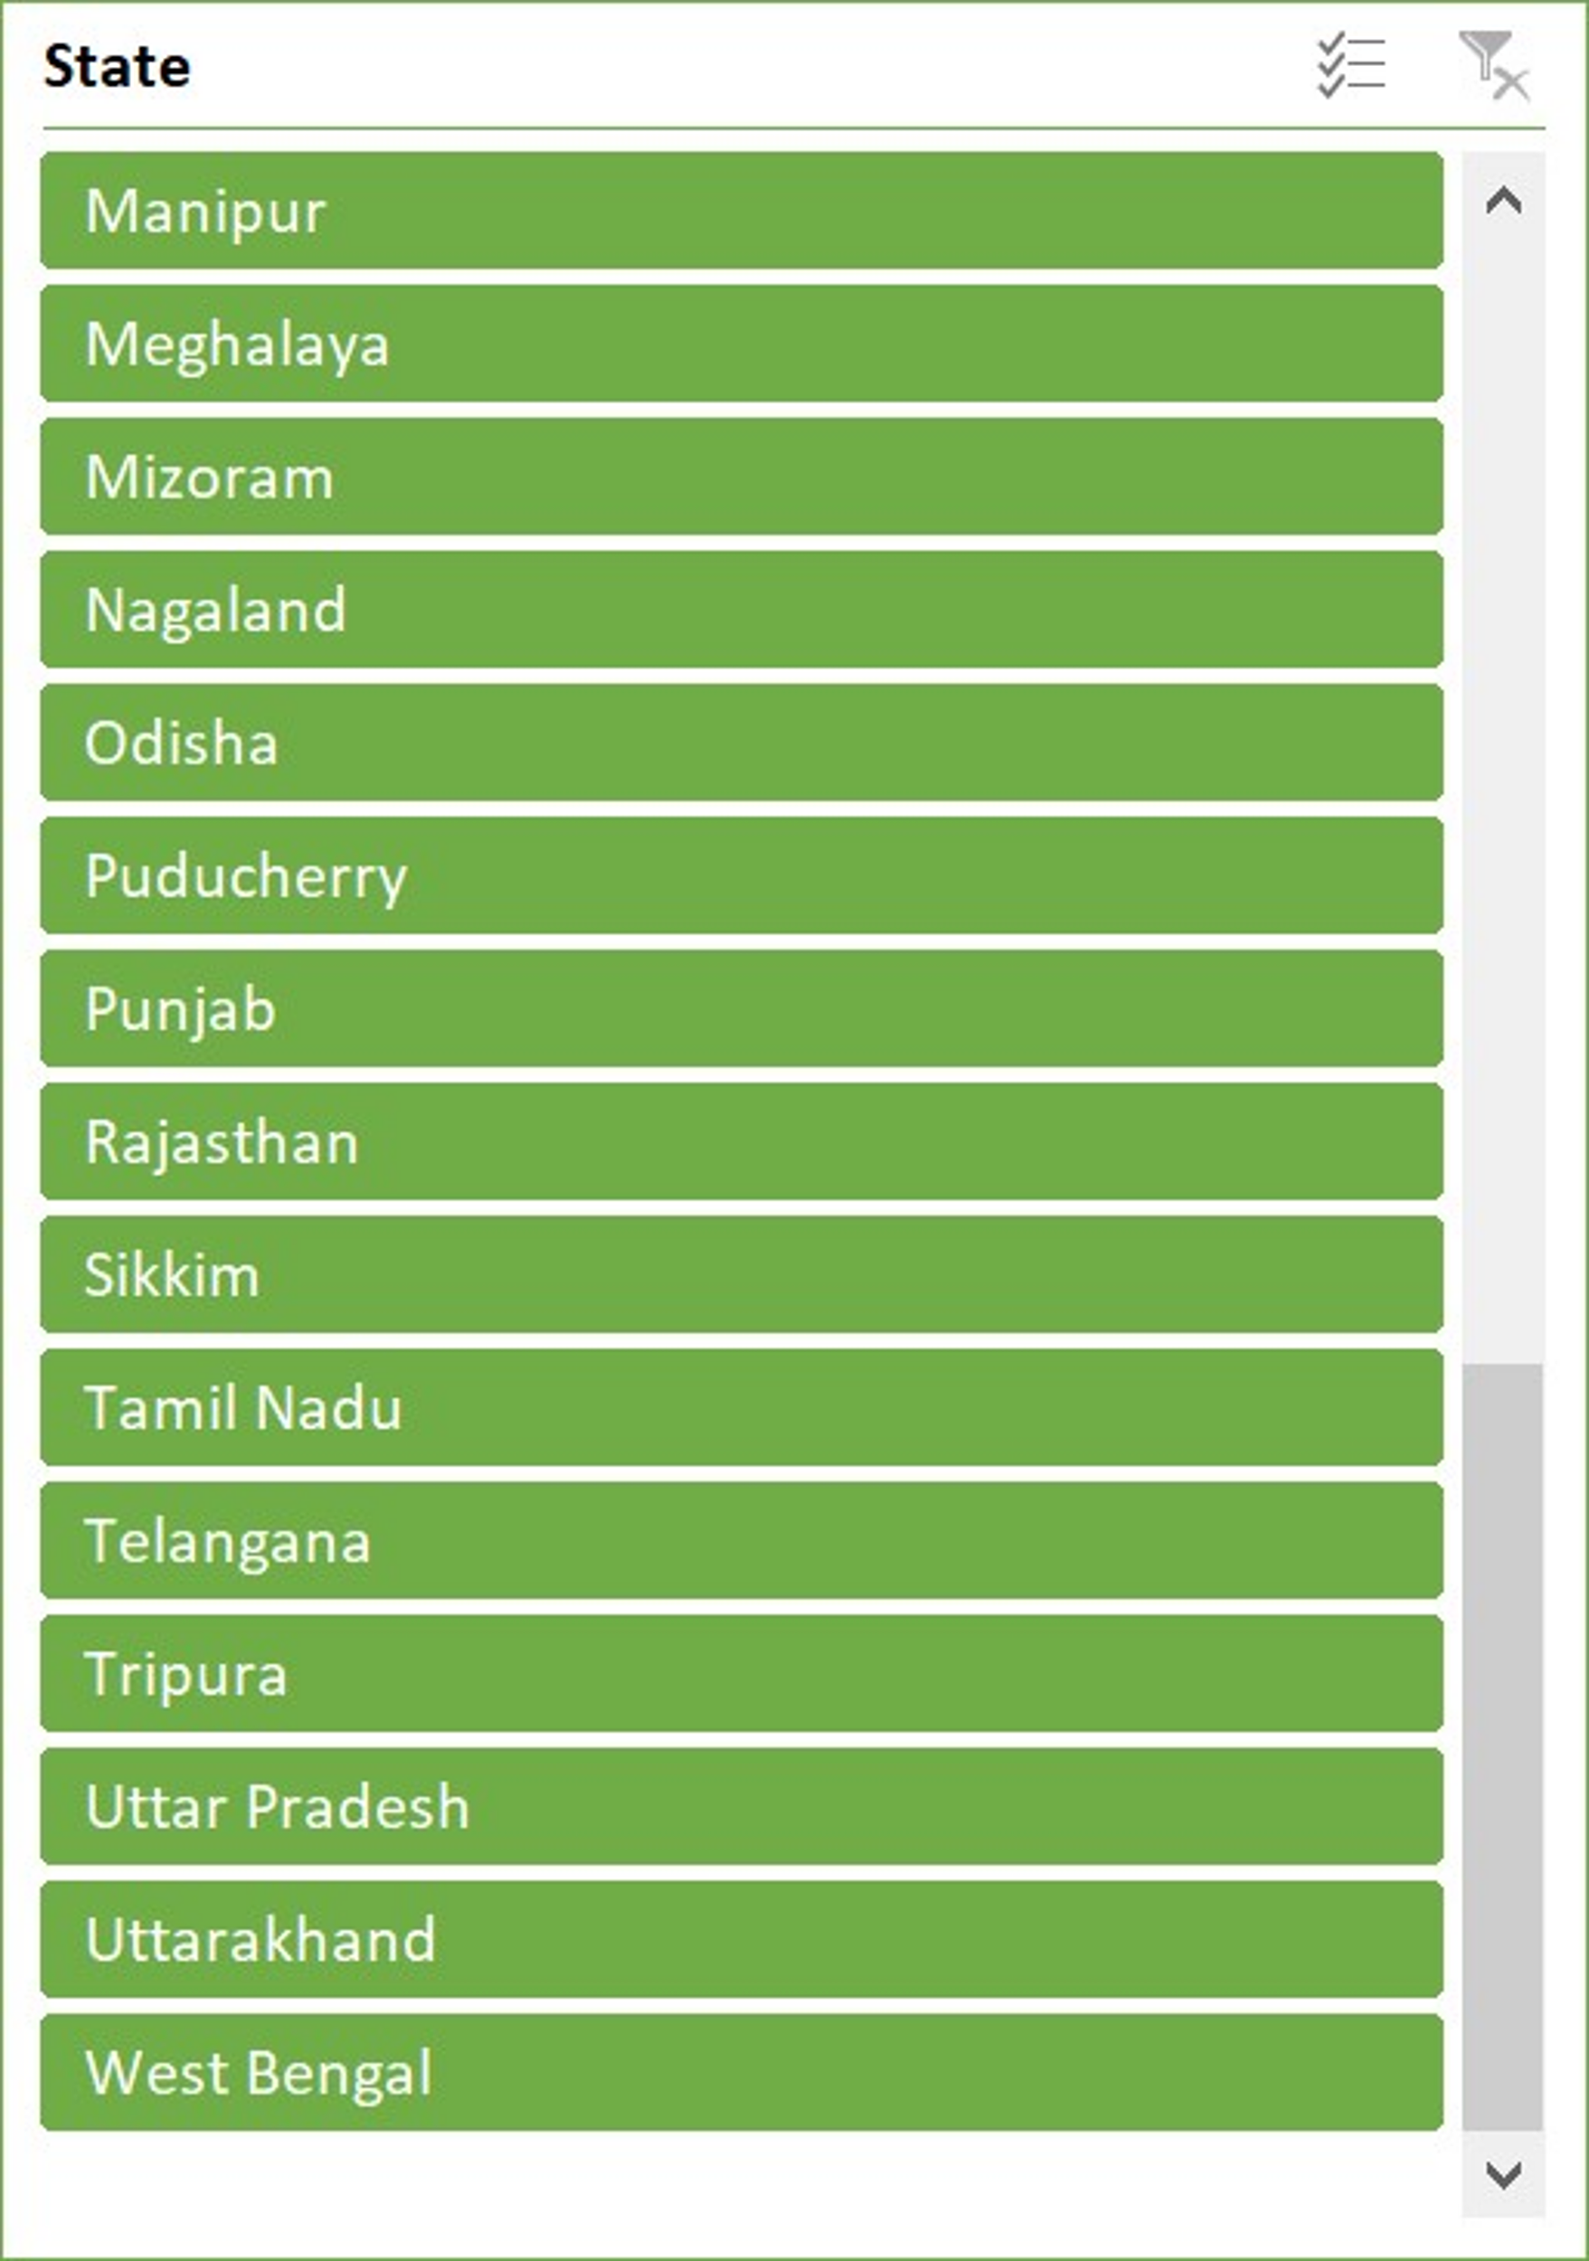
Male and Female Vaccinated ratio for Covid19
STATES | Male(Vaccinated) | Female(Vaccinated)
Andaman and Nicobar Islands | 5525173 | 4679222
Andhra Pradesh | 368956824 | 384371948
Arunachal Pradesh | 15690340 | 12546790
Assam | 177301094 | 149094370
Bihar | 457334240 | 399979888
Chandigarh | 14959749 | 11145458
Chhattisgarh | 261703202 | 274134666
Dadra and Nagar Haveli and Daman and Diu | 10446644 | 6055162
Delhi | 234880916 | 165735672
Goa | 22340619 | 20979805
Gujarat | 746153392 | 641997586
Haryana | 254285829 | 216980174
Himachal Pradesh | 96900109 | 99219151
India | 9291513948 | 8171807437
Jammu and Kashmir | 155315862 | 103272091
Jharkhand | 197854426 | 174143682
Karnataka | 567343701 | 575265047
Kerala | 367341380 | 423829307
Ladakh | 6649151 | 5529159
Lakshadweep | 1577941 | 1205559
Madhya Pradesh | 559330137 | 461589018
Maharashtra | 966770949 | 827976235
Manipur | 19975968 | 14754142
Meghalaya | 18624970 | 17042973
Mizoram | 14107205 | 13411957
Nagaland | 14066403 | 9559207
Odisha | 345643319 | 309083171
Puducherry | 12214797 | 11649550
Punjab | 208079122 | 157221402
Rajasthan | 752840347 | 686528394
Sikkim | 11767345 | 10062533
Tamil Nadu | 389248013 | 344530055
Telangana | 273584279 | 252868696
Tripura | 64597066 | 59814364
Uttar Pradesh | 900954451 | 680487056
Uttarakhand | 117590037 | 110130186
West Bengal | 656425536 | 532128855
Grand Total | 18579894484 | 16340809968
Total number of Male vaccinated is 18579894484 and total number of female vaccinated is 16340809968

Slide 21
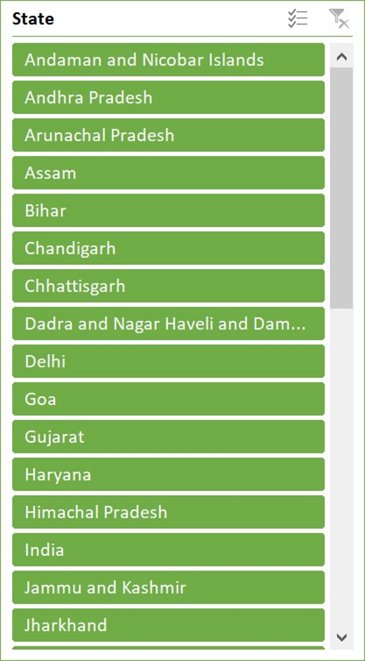
Covaxin and Covishield Vaccination and Doses administered vs People Vaccinated
STATE | Sum of Total Doses Administered | Sum of Total Individuals Vaccinated | Sum of Total Covaxin Administered | Sum of Total CoviShield Administered
Andaman and Nicobar Islands | 11328986 | 9942734 | 0 | 11296006
Andhra Pradesh | 912176783 | 716034336 | 155998977 | 753363528
Arunachal Pradesh | 33915468 | 27207820 | 1820 | 33778691
Assam | 383430299 | 311510720 | 68953907 | 313925975
Bihar | 981851927 | 830004925 | 77972516 | 902049317
Chandigarh | 31023221 | 25032505 | 20089 | 30969272
Chhattisgarh | 614988398 | 517114289 | 20137520 | 593696922
Dadra and Nagar Haveli and Daman and Diu | 18260124 | 16009176 | 216 | 18244317
Delhi | 484044354 | 378882235 | 139775575 | 343431470
Goa | 50051368 | 41881842 | 625054 | 49361534
Gujarat | 1665839883 | 1320172816 | 190944782 | 1471653056
Haryana | 536137585 | 453956778 | 72959714 | 462109115
Himachal Pradesh | 224816467 | 189548517 | 25713 | 224286633
India | 20410132525 | 16754776975 | 2204448108 | 18160886892
Jammu and Kashmir | 297592817 | 250248591 | 4041629 | 293261749
Jharkhand | 425508266 | 359046296 | 53348766 | 371558101
Karnataka | 1322772314 | 1096856361 | 136080860 | 1182850587
Kerala | 934050209 | 751401019 | 64541503 | 867496055
Ladakh | 14771706 | 11528285 | 910 | 14749455
Lakshadweep | 3261957 | 2686210 | 75 | 3259807
Madhya Pradesh | 1149551654 | 989725813 | 133147945 | 1013956777
Maharashtra | 2093453169 | 1717369357 | 240073678 | 1850467667
Manipur | 40420488 | 33838992 | 743 | 40369406
Meghalaya | 41445674 | 34701328 | 2275 | 41375617
Mizoram | 31490503 | 26838882 | 137 | 31380797
Nagaland | 27693394 | 22891022 | 3736 | 27598490
Odisha | 760887775 | 628806269 | 73242639 | 685309240
Puducherry | 27114043 | 23035660 | 7808 | 27080340
Punjab | 414182210 | 352568871 | 36769861 | 376830756
Rajasthan | 1663653177 | 1390911300 | 128966784 | 1531126826
Sikkim | 25897087 | 20925439 | 3239 | 25856288
Tamil Nadu | 864942200 | 702609890 | 131944496 | 732273281
Telangana | 606720187 | 507318557 | 96803545 | 506506123
Tripura | 157417885 | 117259589 | 1187646 | 155840420
Uttar Pradesh | 1836649011 | 1526352061 | 207119612 | 1623684578
Uttarakhand | 273769984 | 217779307 | 7614733 | 265656704
West Bengal | 1443060973 | 1126839571 | 161606268 | 1278797524
Grand Total | 40814304071 | 33503614338 | 4408372879 | 36316339316
Total Covaxin administrated is 4408372879 and CoviShield administrated is 36316339316

Slide 22
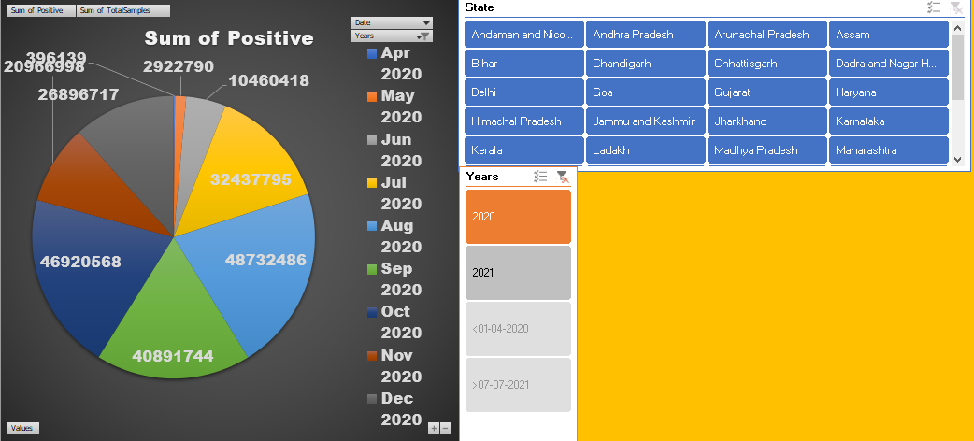
POSITIVE CASES OF DIFFERENT STATES ACCORDING TO YEAR
In the year 2020, the highest positive cases in India is in the month August.

Slide 23
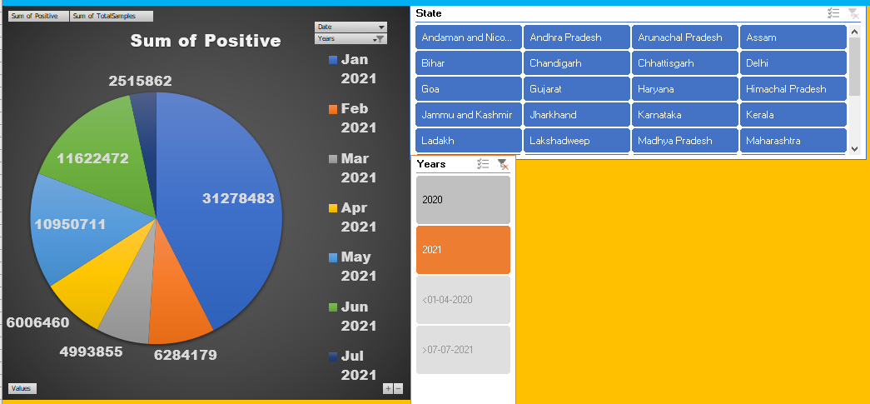
In the year 2021, the highest positive cases in India is in the month January.

Slide 24
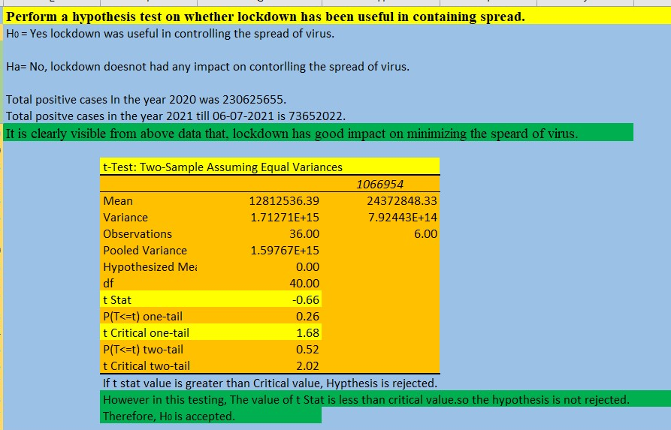
Hypothesis is accepted as the t Stat value < t Critical value. Therefore we can say that, Lockdown was useful in controlling the spread of virus.

Slide 25
Thank you

